Slide 1
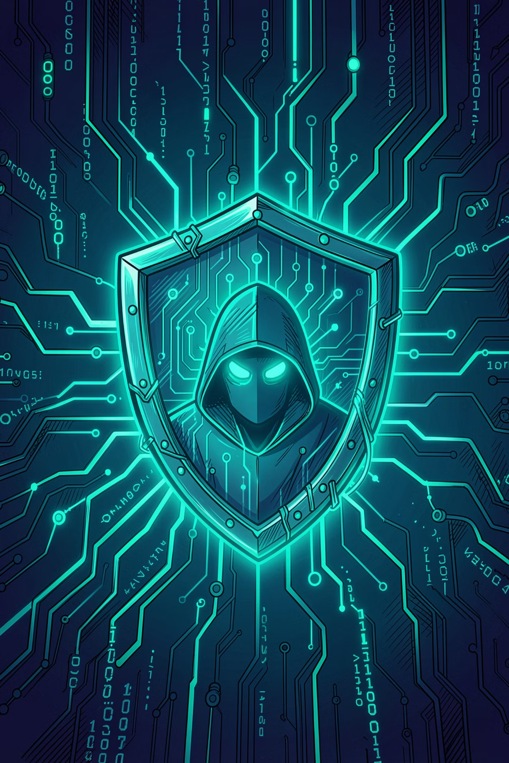
Phishing Awareness Training
CodeAlpha Cyber Security Internship Project
Prepared by: P Subham Rao

Slide 2
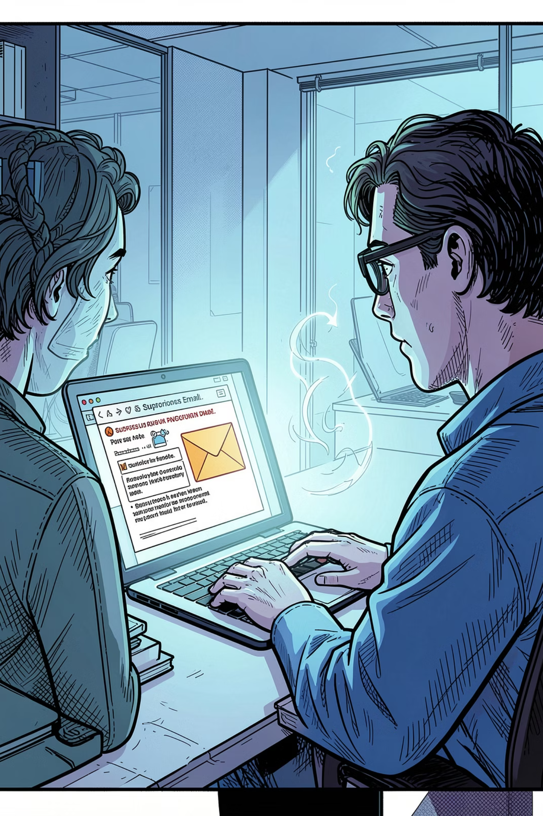
What Is Phishing?
Phishing is a cyber attack where hackers use fake emails, websites, messages, or phone calls to trick victims into revealing sensitive information — including passwords, banking details, OTPs, and usernames.
🎣 Deceptive
⚡ Fast
Disguised as trusted brands, banks, or colleagues
Attacks happen in seconds — often before you react
💸 Costly
Phishing causes billions in losses globally every year

Slide 3
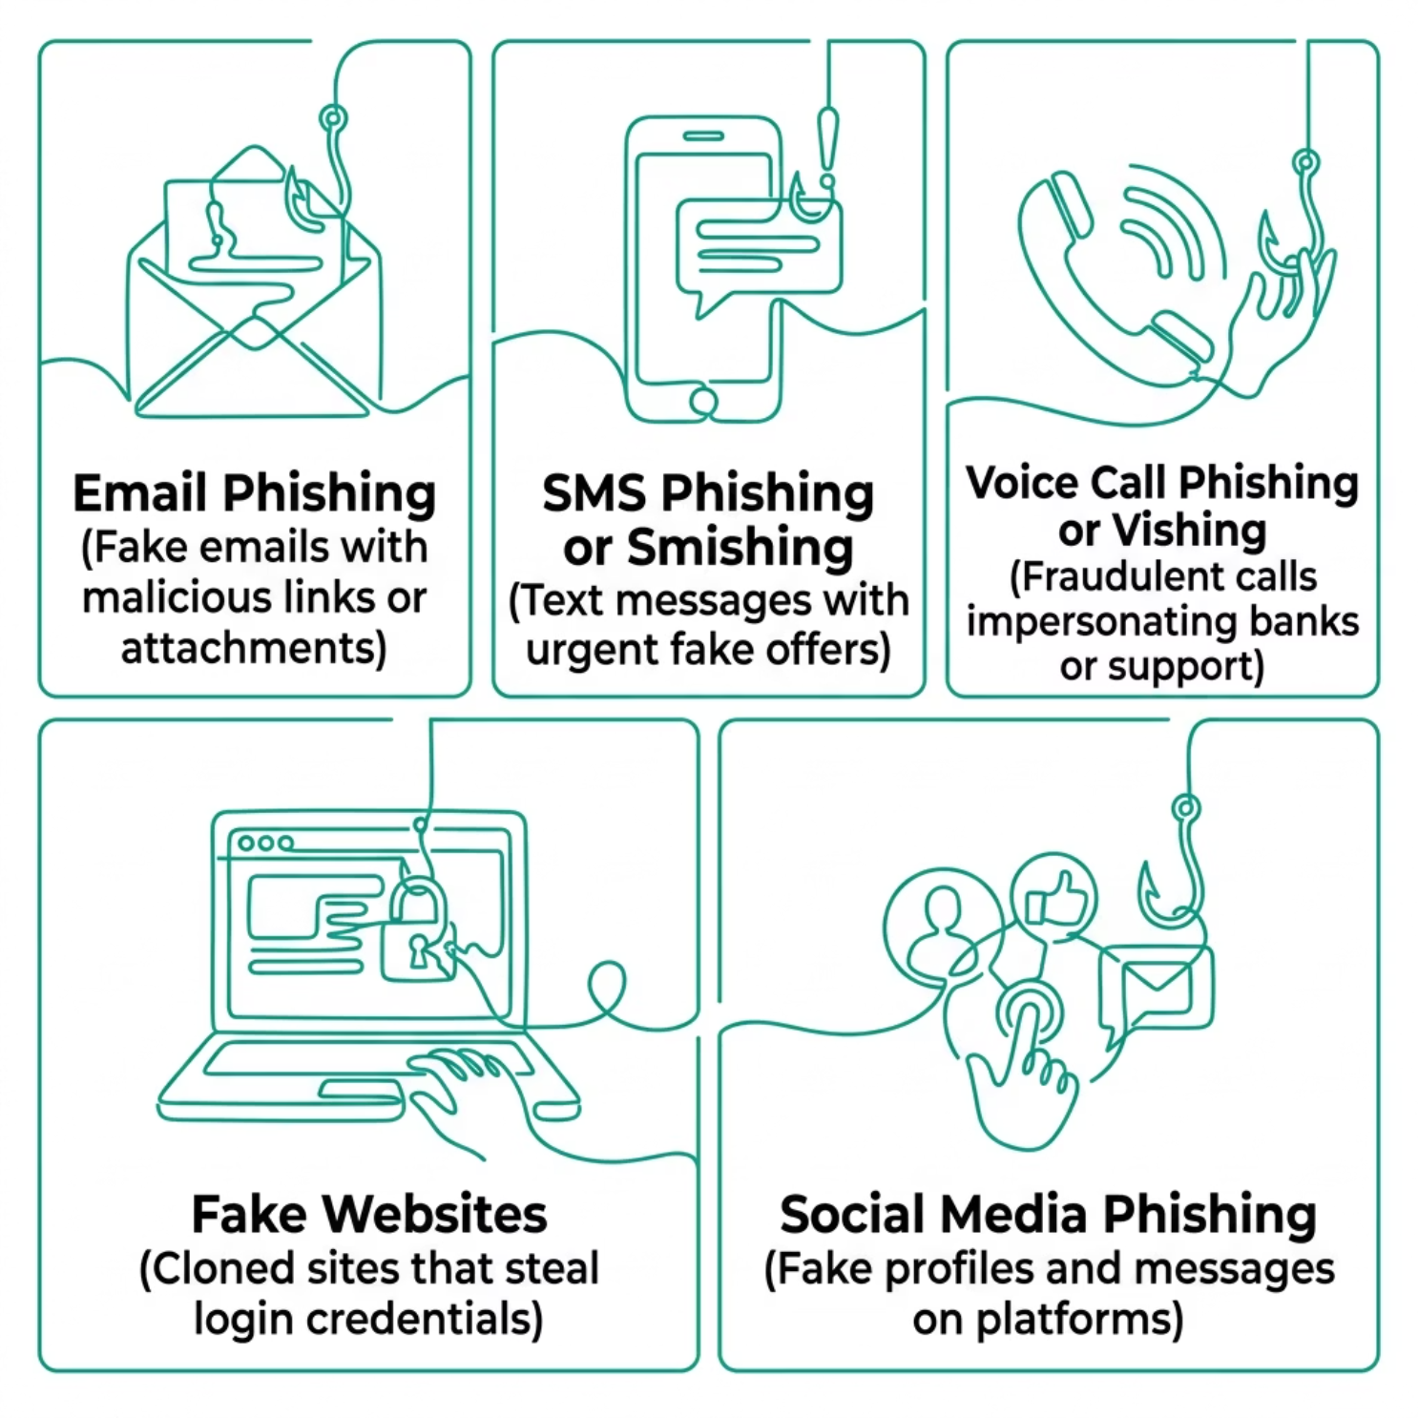

Types of Phishing Attacks
Phishing takes many forms. Knowing each type helps you recognize and avoid them.
Stay Alert Across Every Channel
Attackers don't limit themselves to email. They exploit text messages, phone calls, social media, and fake websites to reach you wherever you are most vulnerable.
Over 90% of cyber attacks begin with a phishing email — but smishing and vishing are rapidly growing threats.

Slide 4
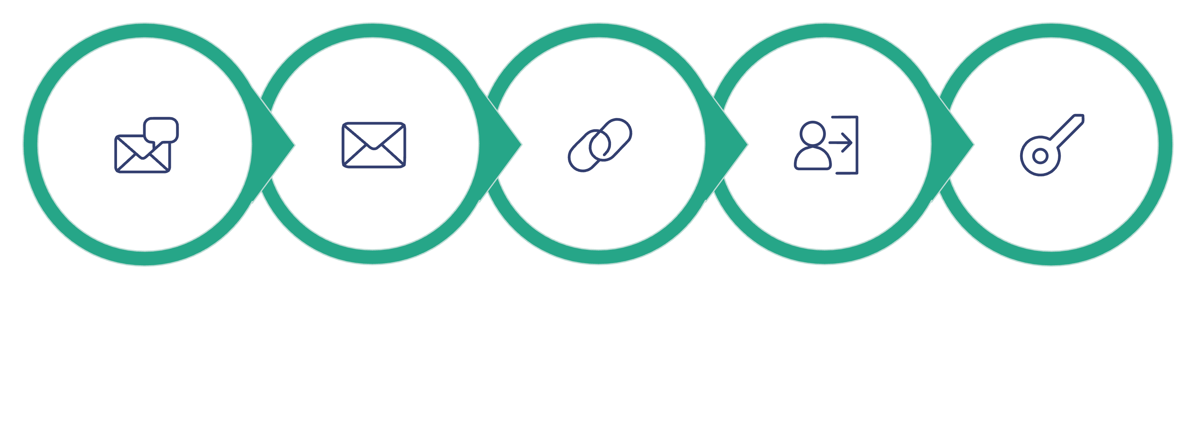
How a Phishing Attack Unfolds
Every phishing attack follows a predictable pattern. Understanding the steps helps you break the chain before damage is done.
Enter Credentials
Fake Message
Fake Login
Delivery
Click Link
The entire attack can take under 60 seconds. Spotting the warning signs at any step can stop it completely.

Slide 5
Spotting a Phishing Email
⚠️ Example Phishing Email
🔍 Warning Signs
Subject: URGENT: Your Bank Account Will Be Suspended!
From: support@paypa1-secure.com
"Click here immediately to verify your account or it will be suspended within 24 hours."
Suspicious sender — look-alike email addresses
Urgency tactics — pressure to act fast
Grammar errors — poor spelling or awkward phrasing
Unknown links — hover before clicking
Requests for personal data — banks never ask via email

Slide 6

Real vs. Fake Websites
Attackers clone legitimate websites to steal your credentials. Always check the URL before entering any information.
✅ Real Website
❌ Fake Website
www.google.com
www.g00gle-login-security.com
Correct spelling and domain
HTTPS encryption enabled
Official branding and design
Trusted SSL certificate
Misspelled or substituted characters
Extra words like "login" or "secure"
May lack HTTPS or show warnings
Designed to mimic the real site
Attackers register look-alike domains to deceive users. Always type URLs manually.

Slide 7
Prevention & Safety Tips
Verify the Sender
Avoid Suspicious Links
Check email addresses carefully — attackers use look-alike domains.
Hover over links to preview the URL before clicking.
Use Strong Passwords
Enable 2FA
Use unique, complex passwords for every account.
Two-Factor Authentication adds a second layer of protection.
Keep Software Updated
Check Website URLs
Updates patch vulnerabilities that attackers exploit.
Always verify the domain name before entering credentials.

Slide 8
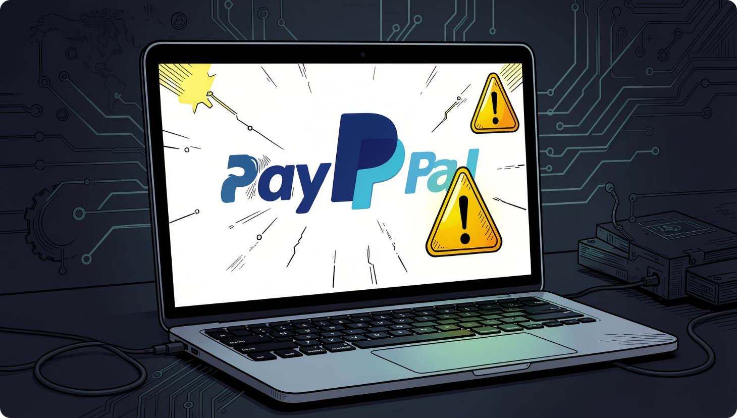
Case Study: PayPal Phishing Scam
What Happened
Attackers sent emails impersonating PayPal, claiming accounts were "limited" or "suspended." The emails contained links to convincing fake login pages that captured real credentials.
Impact
Thousands of users had accounts compromised
Financial losses and identity theft reported
PayPal's brand reputation was exploited
Key Lesson
PayPal never asks for your password via email. Always navigate to the official site directly — never through email links.

Slide 9
Quick Awareness Quiz
Test your knowledge before you go.
1
2
3
What is phishing?
Should you trust urgent emails asking for passwords?
What does 2FA mean?
A cyber attack using fake communications to steal sensitive information like passwords and banking details.
Two-Factor Authentication — a second verification step (like a code sent to your phone) that protects your account.
No. Legitimate organizations never request passwords via email. Urgency is a common phishing tactic.
"Cybersecurity awareness is the first line of defense against phishing attacks."

Slide 10
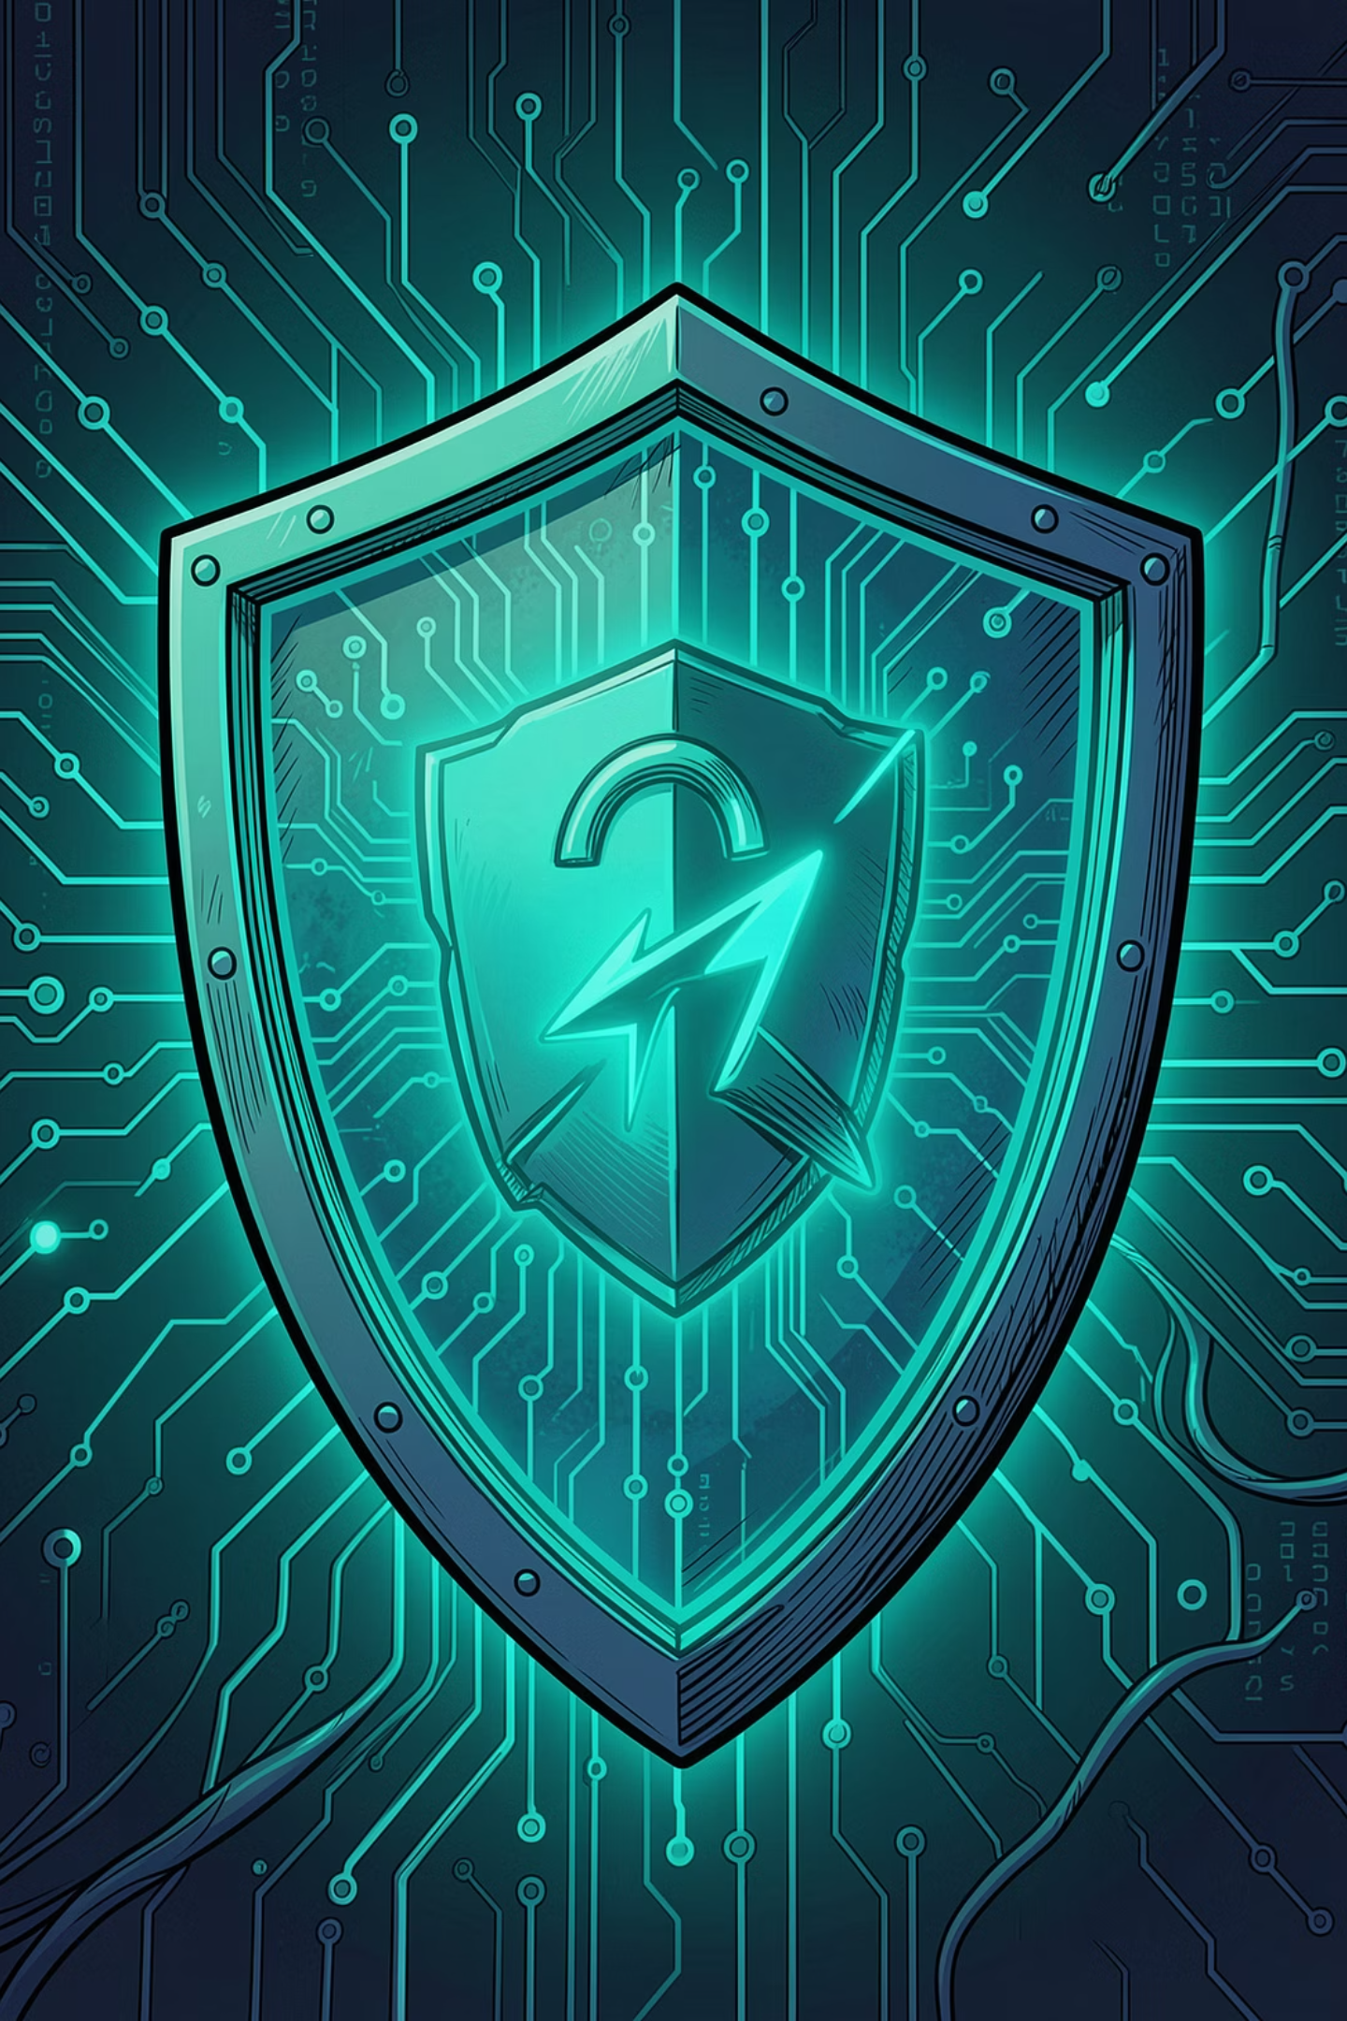
Thank You
Stay vigilant. Stay secure. Share what you've learned.
🎣 Recognize
🛡️ Protect
Know the signs of phishing
Apply best practices daily
📢 Educate
Share awareness with others
CodeAlpha Cyber Security Internship Project · Prepared by
P Subham Rao

